Slide 1
Marketing Practices: Higher Education Career Services
Presented by Kendra K. Evans, Mary Kay Rickard, and Doreen Sams

Slide 2
Introduction
Presenters’ Backgrounds
Kendra K. Evans
Mary Kay Rickard
Doreen Sams
The study answers the question:
To what extent are the subject IHE's CS’ outbound marketing strategies successfully creating awareness and increasing attendance at CFs?
Notes:
JASON

Slide 3
Purpose of the Study
To look at career fair marketing from a research perspective
To understand best practices for reaching students and increasing attendance at career fairs
Address why, students move from awareness to attendance of career fairs at Institution of Higher Education (IHE) Career Center’s
Address the effectiveness of outbound marketing strategies
Define outbound marketing

Slide 4
How confident are you that your marketing efforts are successful in attracting participants to your events?

Slide 5
Which of the follow social media platforms do you use to promote events? Which is the most successful?
Facebook
Instagram
Snapchat
Tik Tok
Twitter
Other_______________
None

Slide 6
To what extent do you use … to promote events?
Email Blasts
Website
Both
Neither

Slide 7
Study Methodology
Analyzed data from IHE’s Career Service Effectiveness of outbound strategies
Student intercept survey at career fairs
Three academic years
Compared to emails sent
Social media analysis
Facebook (2010 – 2019)
Content Analysis
Changes in Effective

Slide 8
Do you use calls to action?
Email Blasts
Social Media
Website
Other______________

Slide 9
Comparison with Reported - Survey Received by Email - Effectiveness
Email Blasts Population
Fall 2017
N = 3,997
Spring 2018
N = 3,105
Fall 2018
N = 3,280
Email Blasts Population
Spring 2019
N = 3,358
Fall 2019
N = 4,110

Slide 10
Do you depend on faculty to promote career events? If so, how does that work for you?

Slide 11
 | Fall 2017 Career Fair | Spring 2018 Career Fair | Fall 2018 Career Fair | Spring 2019 Career Fair | Fall 2019 Career Fair
Career Fair Attendees | 324 | 284 | 276 | 403 | 458
Attendance as a % of total # of emails sent | 8.10% | 9.10% | 11.25% | 12% | 11.10%
Intercept Survey Responses | 203 | 168 | 219 | 104 | 364
Percent Responded to intercept survey | 62.70% | 59.50% | 79.34% | 34.80% | 79.50%
Responses to how they found out about the career fair
Email | 23.65% | 23.21% | 17.11% | 15.71% | 25%
Personal Selling Referral (Faculty Invites) | 24.63% | 25.00% | 29.10% | 42.14% | 36.54%
Career Center Staff Referral (office appointment) | 17.73% | 20.83% | 21.03% | 22.14% | 11.54%
Other Referral (Facebook, career services newsletter, etc.) | 1.97% | 1.19% | 7.82% | 1.43% | 2.47%
Flyers/Signs | 13.79% | 10.71% | 4.65% | 7.14% | 8.97%

Slide 12
Social Media
Findings
Since the Career Center's Facebook page's creation, the page as of this study had received only 2,140 likes and only 2,227 followers
Facebook page contained no calls to action
Pew Research Report (PR)- number of Facebook users remaining nearly the same since 2016
2018 PR report found - Facebook usage among US teens dropped in recent years
Same age group that makes up the target market for the IHE (Perrin and Anderson, 2019)

Slide 13
Analyses
Career fair intercept self-report survey data
Frequency analyses to identify the marketing strategies that most frequently elicited students' attendance
Comparison analysis
IHE Career Center's Facebook page data of likes and followers
Examined with frequency analysis to determine if and in what directions the strategy to reach students using Facebook changed over time

Slide 14
Conclusions
Supports concepts that best practices in marketing strategies applied by educational organizations can improve the efficiency and effectiveness of the service providers' marketing tactics
Personal selling continually ranked the highest in effectiveness (not sustainable)
Gen-Z's preference for individual attention and personalized instruction

Slide 15
How are your marketing responsibilities divided within the career center?

Slide 16
What limits your ability to market your events?

Slide 17
Conclusions
Findings show the importance of marketing
Personnel dedicated to marketing would improve career centers’ ability to market and share their service offerings with currently enrolled students
Personalizing the message through personal selling is useful
Gen Z workplace coaching "one-on-one, custom-tailored learning, and development process that uses a collaborative, reflective, goal-focused relationship to achieve professional outcomes are valued
Inbound email marketing (opt-in) may be an effective way of reaching students with the Career Center’s service offerings

Slide 18
Recommendations
Effective marketing creates a space where less selling of the service is needed
Today’s career center’s personnel must employ a reasonably new vocabulary that includes terms like market research, market penetration, positioning, market audits, and marketing strategies
Goal is to generate leads with outbound marketing and use inbound marketing to nurture leads
Recommend adopting inbound marketing for those in your brand communities and co-branding obtained from outbound marketing strategies
Use other social media and measure the outcomes
Twitter, Instagram, Snapchat, LinkedIn, etc.

Slide 19
Inbound Marketing
Based on attracting customers and creating one-to-one relationships through the use of relevant content
Focused on building relationships and providing support to pull students from awareness to engaging with career center
Strategies can include
Blogs
Ebooks
Opt-in emails
Podcasts
Videos
Content Marketing

Slide 20
Limitations of the Research
Information from IHE Career Center's career fairs across five academic semesters
Self-report intercept surveys also limits the study
Using information from IHEs Career Center office self-report intercept surveys and internal records, the study's findings inform other IHE on-campus service providers of best practices
Outbound marketing data were limited
The study was limited in scope and time

Slide 21
Next Steps
Conduct a more extensive study across multiple IHEs of varying sizes, demographics, and types
Survey students to whom career fair promotional emails were sent but who did not attend to determine if they opened the email; if so, did they read it, and if so, why did they not attend
Examine other outbound marketing tools
A study across multiple semesters is recommended to determine effectiveness

Slide 22
Applications
Although many career centers do not have a designated marketing professional, our research shows that it would be beneficial
Recommend marketing best practices to follow for those who do not have a dedicated marketing professional
Generate leads with outbound marketing
Use inbound marketing to nurture leads
Utilize calls to action in social media

Slide 23
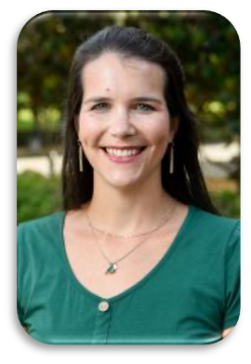
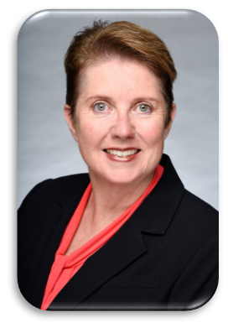
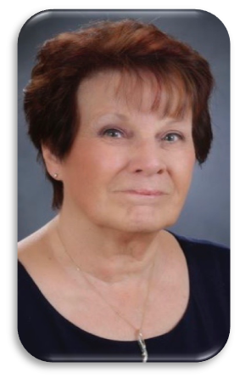
Thank you for your attention!

Slide 24
Questions and Comments

